Slide 1
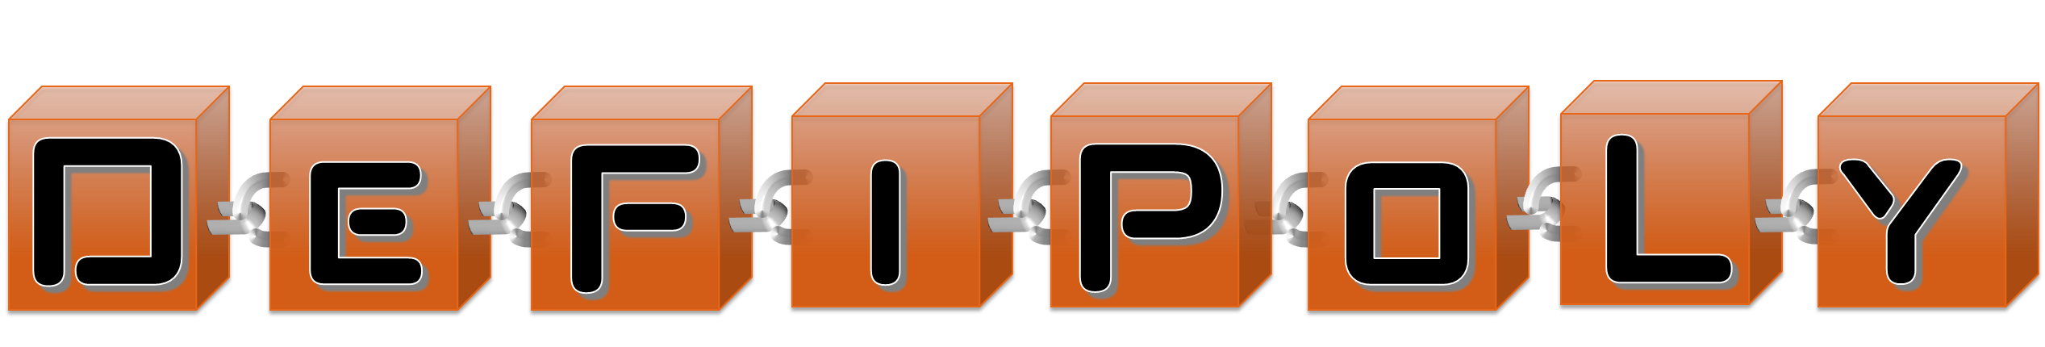
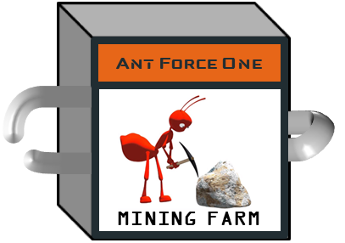
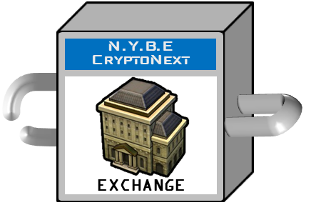
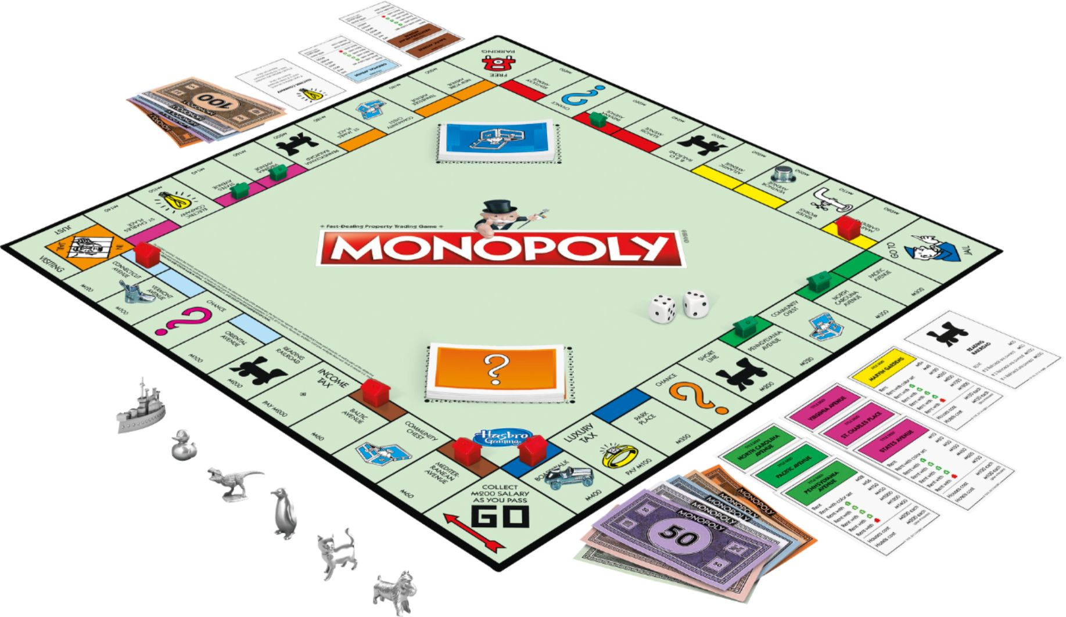
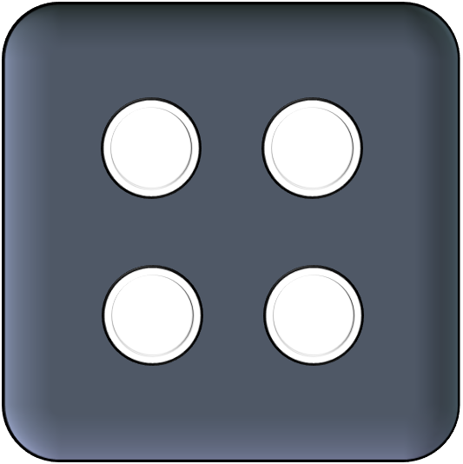
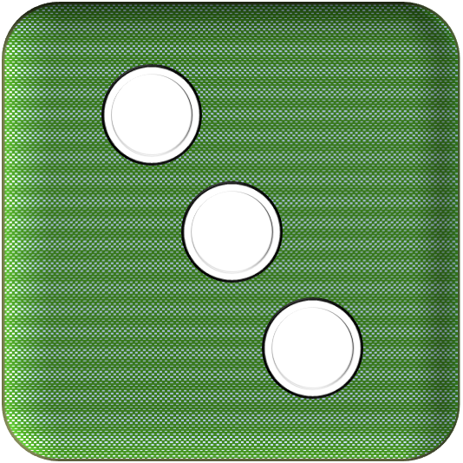
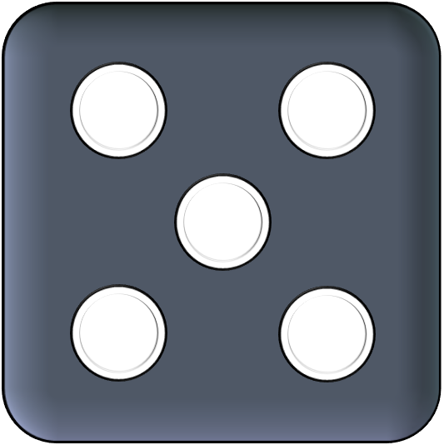
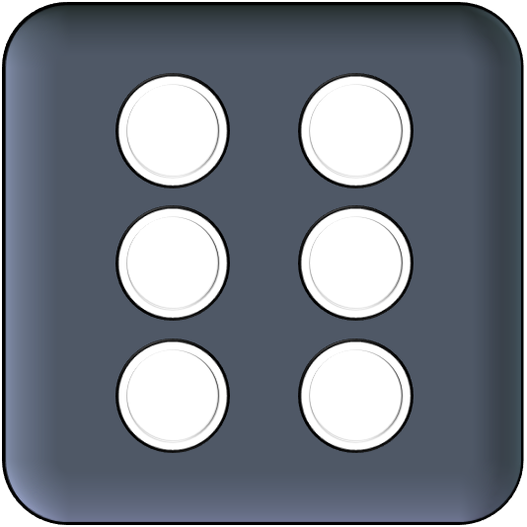

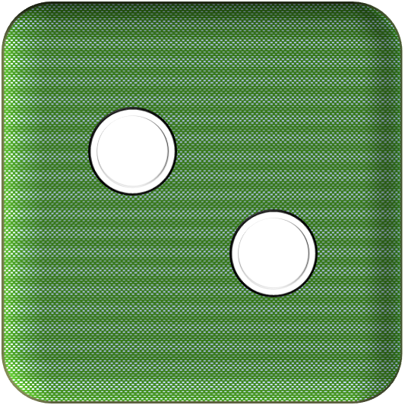
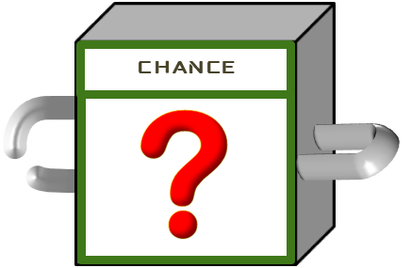
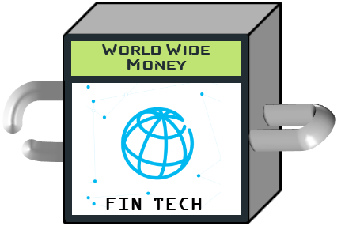


Slide 2
Challenge | Solution
Full decentralisation requires random number | CHAINLINK (VRF)
Seamless connection for users that doesn’t have an ETH account yet | PORTIS
Fast and cheap transactions | Layer 2 (MATIC)
No fees transactions Users doesn’t have native token (ETH on L1, MATIC on L2) | Gas Station Network
Fund the Gas Relay | Pool Together (on layer 1 !) Prize strategy = earned interest → Gas Relay Fund Gas Relay checks the TX signer has contributed to the pool (ticket token)
Pool Together fund on Layer 1, Gas Relay on Layer 2 | ?? Transfer ticket token from L1 to L2 ?? Oracle (CHAINLINK) to request L1 info from L2
Users have to connect both on L1 (to contribute to the pool) and L2 (to play game) | PORTIS

Slide 3






Layer 1
PrizeStrategy
Front-end
Layer 2
GameFactory contract
GameMaster contract
Token contract
Oracle
Gas Relay L2
Asset contract
….

Slide 4
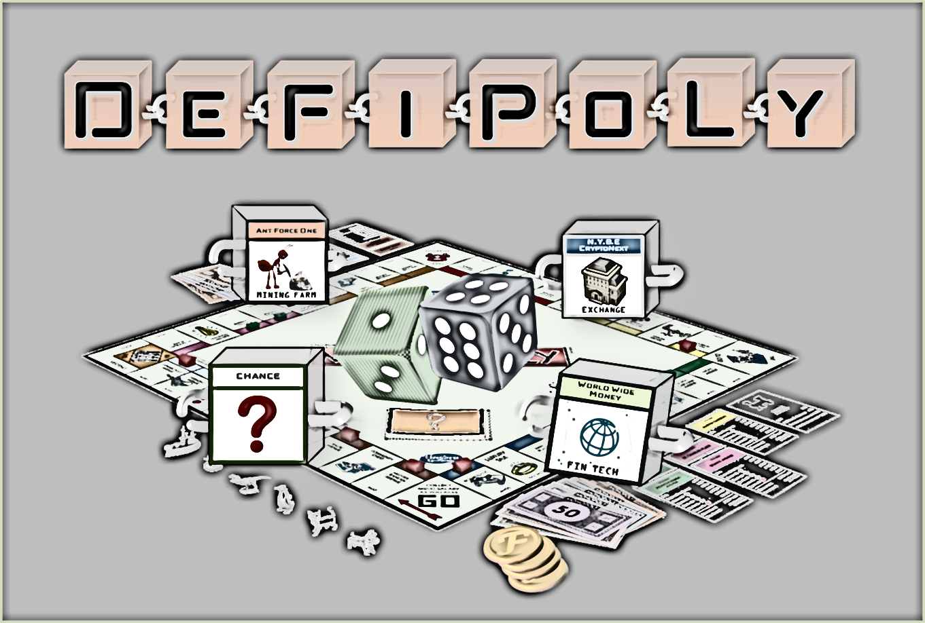
Demo

Slide 5
Achievements | Remains to be done
GameFactory contract: create contracts for a new game session | Complete game mechanisms in smart contracts
Initial front-end project, connection on L1 and L2 with PORTIS | Add VRF feature in CHAINLINK
CHAINLINK node deployed on MATIC | Integrate POOL-Together with customised Prize Strategy
 | Integrate Gas Relay on Layer 2
 | Complete Front-end

Slide 6

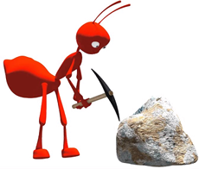
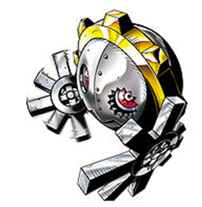








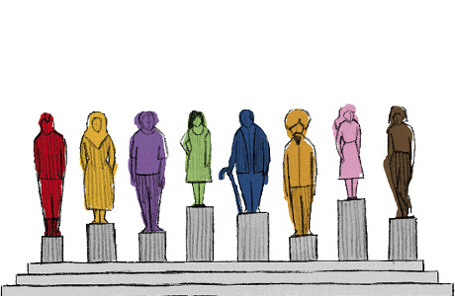


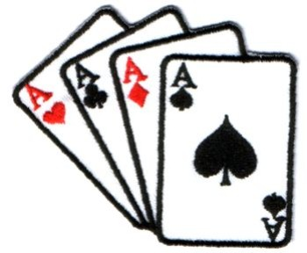


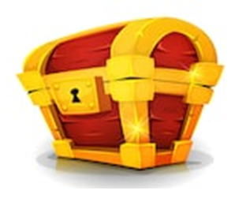



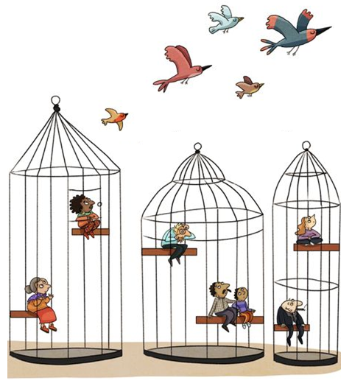
GENESIS
N.Y.B.E CryptoNext
Ant Force One
Remainers
From The Hashes
DecentraLife
Coinbridge
College
EXCHANGE
MINING FARM
GAME
BIO TECH
EDUCATION
COVID-19
The Grand
TezAAr
Pudding King
The Health Chain
World Wide
Money
Wealth Share
MARKETPLACE
BAKERY
BIO TECH
FIN TECH
SOCIAL
CHANCE
CHANCE
The 12
DOOZERS ARMY
Planet
of the Aces
Citizen Chain
Crypto On Chip
MINING FARM
GAME
LAW TECH
HW WALLET
COMMUNITY
CHEST
COMMUNITY
CHEST
Boiler Room
Privacy Connect
Smart Court
QUARANTINE
JUST VISITING
BAKERY
SOCIAL
LAW TECH
This Photo by Unknown Author is licensed under CC BY
This Photo by Unknown Author is licensed under CC BY
This Photo by Unknown Author is licensed under CC BY

Slide 9
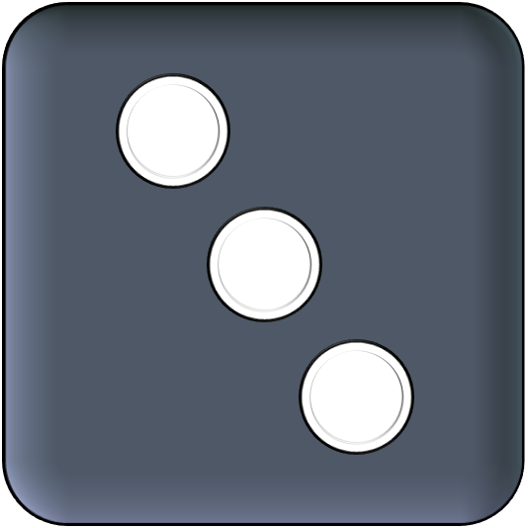
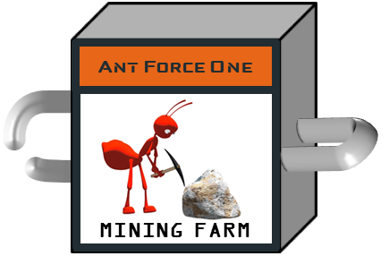


Ant Force One
MINING FARM

Slide 10

LawTech
BioTech
FinTech
EdTech
Gaming
Crypto
StarTech
CyberSec
GreenTech
Social Media

Slide 11



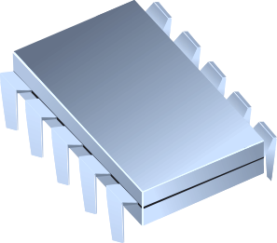



Slide 12
Found A Crypto Startup
Invoke Your Community Chest
Mine And Get Rewards
Stake And Get Rewards
Invest In Your Products
Run A Token Exchange
Launch An ICO
Took A Chance !
Run An NFT Marketplace
Buy/Sell Crypto-Assets

Slide 13

D
e
F
i
Venture
ℱ
ℱ
ℱ
100
L
100
100
100
L
L
POWERED BY:

Slide 14
Venture
D
e
F
i
ℱ
ℱ
ℱ
ℱ
ℱ
100
ℱ
100
100
100
POWERED BY:

